Slide 1



Building a Big Data Analysis Solution with IBM Cloud Database
Welcome to our presentation on building a powerful big data analysis solution using IBM Cloud Database. Learn how to leverage the right database service, set up the instance, and explore and analyze data.
AR
by Ahmed Riyas kaan

Slide 2
Overview of Big Data Analysis Solution
Understanding Big Data
Benefits of Cloud Database
Components of Big Data Solution
Explore the challenges and opportunities presented by big data and why analysis is crucial for decision-making.
Discover the advantages of using IBM Cloud Database for efficient and scalable data storage and analysis.
Learn about the key components required to build a successful big data analysis solution.

Slide 3

Signing up for an IBM Cloud Account
1
Create Your Account
2
Select the Right Plan
Step-by-step guide to creating an IBM Cloud account and accessing the wide range of services.
Choose the plan that suits your needs, from free options to advanced paid plans for enhanced capabilities.
3
Getting Started with IBM Cloud Dashboard
4
Security and Compliance
Ensure your data is protected with advanced security measures and compliance standards provided by IBM Cloud.
Learn how to navigate the IBM Cloud Dashboard and find the necessary tools for database management.

Slide 4
Choosing the Appropriate Database Service
Db2
MongoDB
Explore the powerful features of Db2, a versatile relational database management system for efficient data storage and analysis.
Discover the flexibility and scalability of MongoDB, a NoSQL database solution suitable for handling unstructured and diverse data.

Slide 5
Setting Up the Database Instance
1
Create Database Instance
Step-by-step instructions to provision a database instance in the IBM Cloud and configure its settings.
Configuring Authentication
2
Secure your database and manage access by setting up authentication mechanisms such as username and password.
3
Perform Regular Backups
Implement backup procedures to protect your data and enable fast recovery in case of any unforeseen events.

Slide 6

Developing Queries or Scripts to Explore and Analyze the Selected Database
1
Data Exploration
2
Data Analysis Techniques
Learn how to formulate effective queries to explore and retrieve relevant data from your database.
Discover various analysis techniques and tools to gain valuable insights from your big data.
3
Scripting Efficiency
Optimize your scripting techniques to handle large datasets and perform complex calculations efficiently.

Slide 7
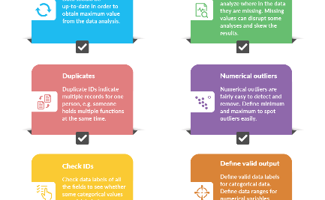
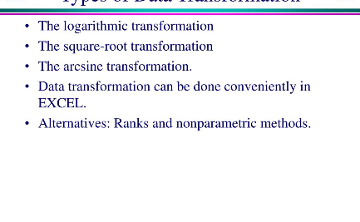
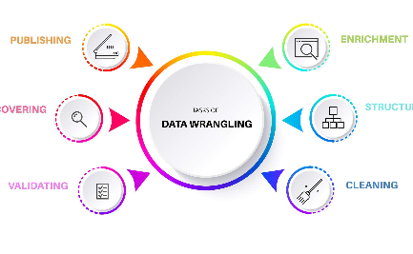
Performing Basic Data Cleaning and Transformation as Needed
Data Cleaning Best Practices
Data Transformation Techniques
Data Wrangling Process
Understand the key steps involved in preparing and shaping data to meet the specific requirements of your analysis.
Learn essential tips and techniques for cleaning messy and inconsistent data and ensuring data quality.
Explore methods to transform data into a consistent format suitable for analysis and visualization.

Slide 8

Conclusion and Next Steps
1
Key Takeaways
2
Further Learning Resources
3
Start Building Your Solution!
Recap the main points covered and the benefits of leveraging IBM Cloud Database for big data analysis.
Discover additional resources and references to expand your knowledge and expertise in big data analysis.
Take the next step in building your big data analysis solution and unlock the potential of your data.

